Slide 1

Real Talk – A Conversation with Section 508 Program Managers
Interagency Accessibility Forum
November 8, 2023
Moderator:
Betsy Sirk, National Aeronautics and Space Administration
Director, Digital Accessibility and Strategic Sourcing
Panelists:
Sid Sharma, US Department of the Interior
Section 508 Program Manager
Mark Urban, Centers for Disease Control/Administration for Toxic Substances & Disease Registry
Accessibility Program Manager
Courtney Ritz, National Aeronautics and Space Administration
IT Accessibility Lead

Slide 2
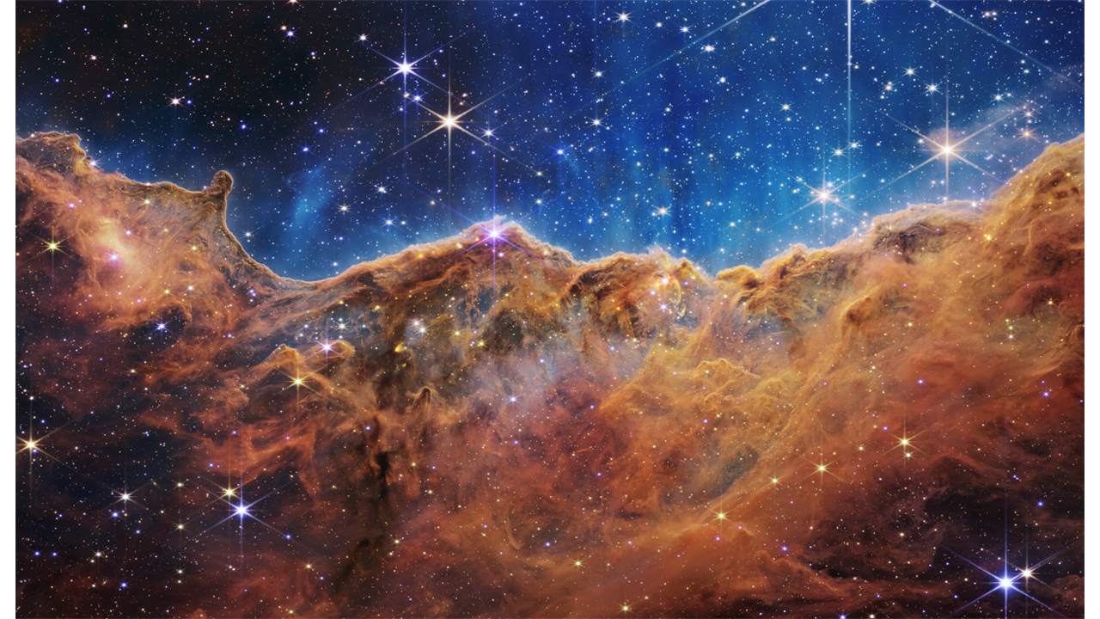
Carina Nebula (NGC 3324) from James Webb Space Telescope July 2022

Slide 3
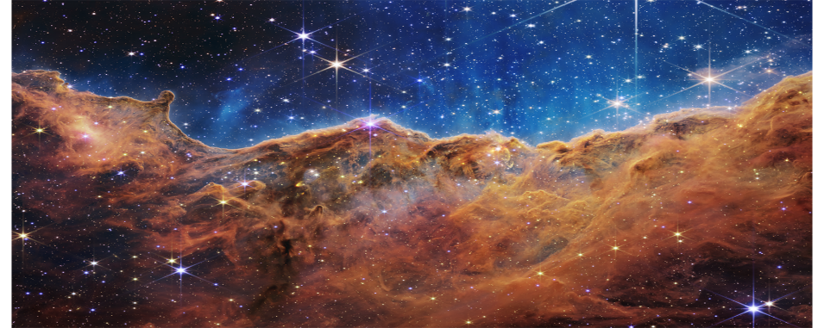
Alternative Text: Making Pictures Accessible to All
Carina Nebula Caption:
Astronomers using NASA’s James Webb Space Telescope combined the capabilities of the telescope’s two cameras to create a never-before-seen view of a star-forming region in the Carina Nebula. Captured in infrared light by the Near-Infrared Camera (NIRCam) and Mid-Infrared Instrument (MIRI), this combined image reveals previously invisible areas of star birth. What looks much like craggy mountains on a moonlit evening is actually the edge of a nearby, young, star-forming region known as NGC 3324. Called the Cosmic Cliffs, this rim of a gigantic, gaseous cavity is roughly 7,600 light-years away.
Picture Description:
The image is divided horizontally by an undulating line between a cloudscape forming a nebula along the bottom portion and a comparatively clear upper portion. Speckled across both portions is a star field, showing innumerable stars of many sizes. The smallest of these are small, distant, and faint points of light. The largest of these appear larger, closer, brighter, and more fully resolved with 8-point diffraction spikes. The upper portion of the image is bluish, and has wispy translucent cloudlike streaks rising from the nebula below. The orangish cloudy formation in the bottom half varies in density and ranges from translucent to opaque. The stars vary in color, the majority of which have a blue or orange hue. The cloud-like structure of the nebula contains ridges, peaks, and valleys – an appearance very similar to a mountain range. Three long diffraction spikes from the top right edge of the image suggest the presence of a large star just out of view.

